Slide 1
Should Juvenile Criminals Be Punished the Same as Adult
Yang Jun Yeop
CE 2 Lec No 012
06-09

Slide 2
Contents
Introduction
Definition
Example of cruel crime
Recidivism of juvenile crime
Conclusion

Slide 3
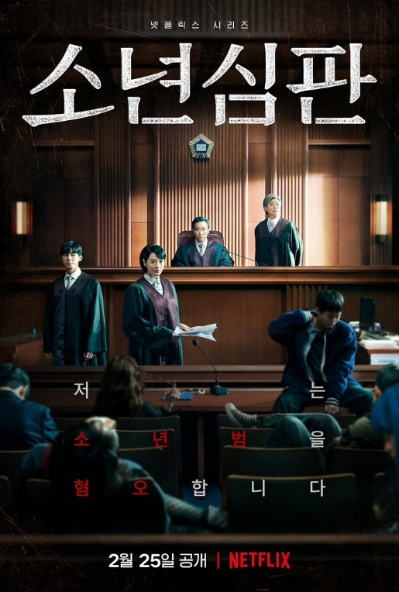
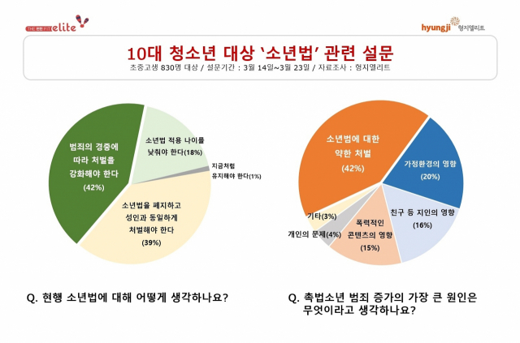
Introduction
Reason: Emotional thoughts, getting worse, controversial
Delivery Student killed by juvenile
Killing mother because of scold
Juvenile punished same as adult

Slide 4
Definition
14-20 juvenile
Under 10 no punish
10-14 no criminal liability, get protection
14-19 juvenile law punishment

Slide 5
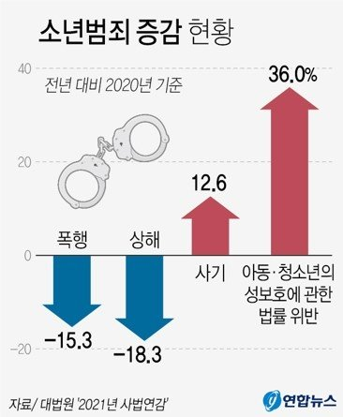
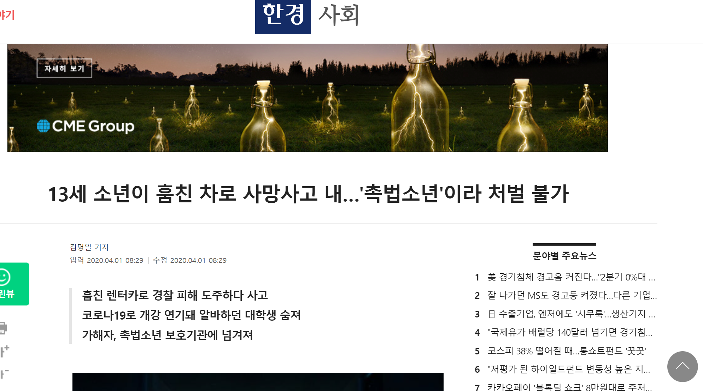
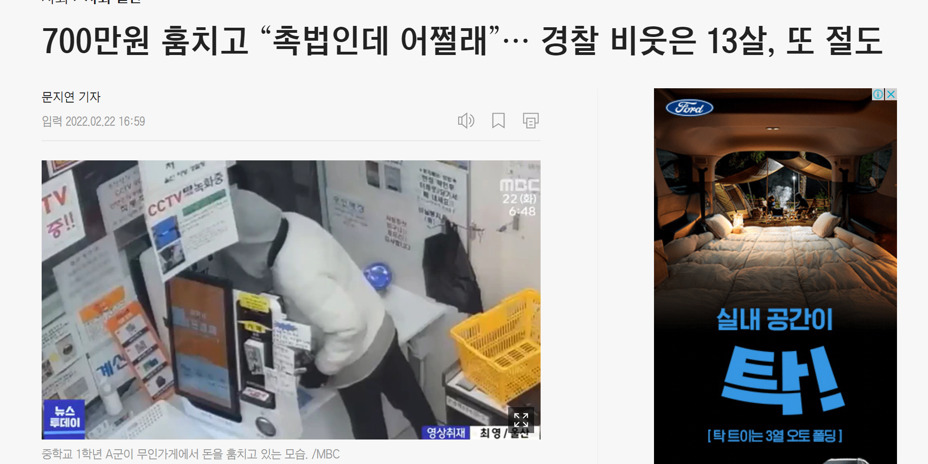
Example of Cruel Crime
Killed delivery student
Stealing unmanned store 7 million won 11 days 20 place

Slide 6
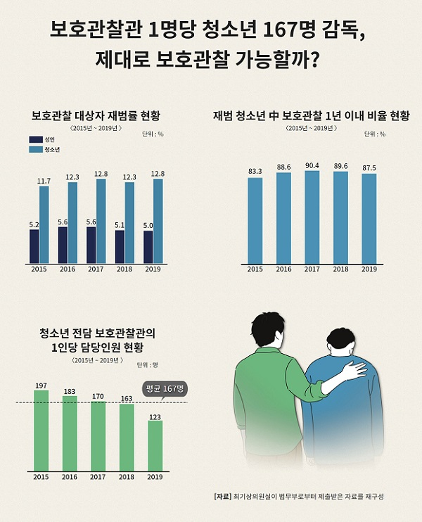
Recidivism of juvenile crime
Three time higher than adult
Not mentally grown

Slide 7
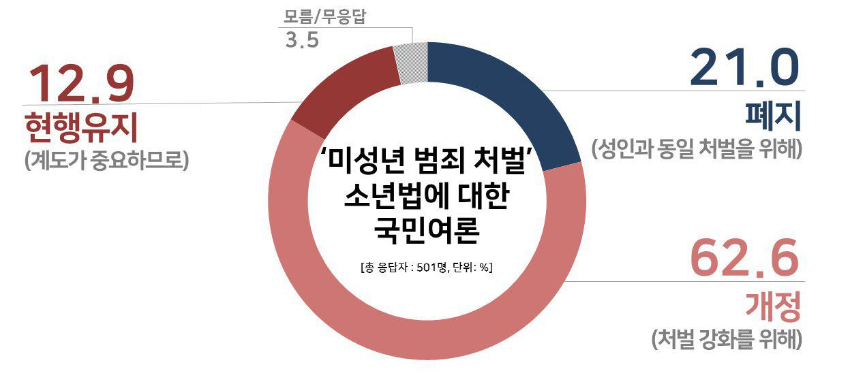
Conclusion
Change of juvenile law
Punished the same as adult
Lower the recidivism, giving attention to child

Slide 8
Thank you for listening to my presentation

